Slide 1
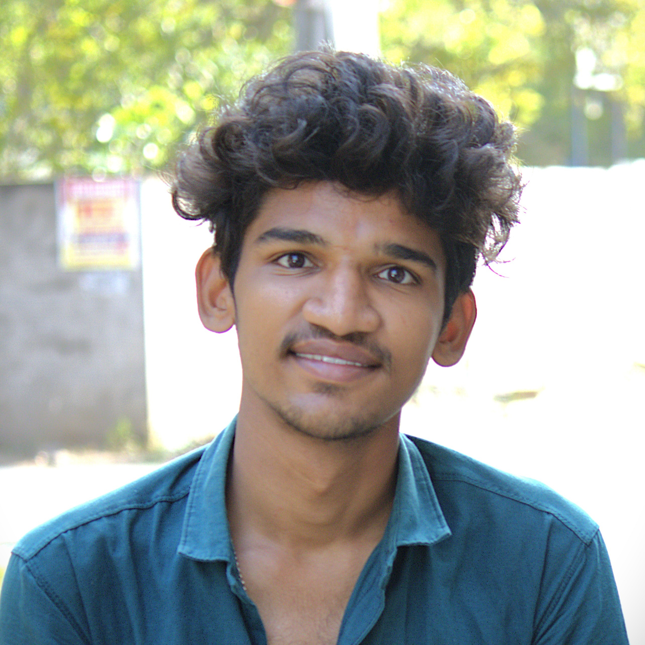

Photo :
Associate ID: 2431147 | +91 97059 54462
Profile:
Programmer Analyst Trainee at Cognizant (2025 – Present), I am passionate about creating inclusive and accessible digital experiences that empower users of all abilities.
With a strong foundation in programming languages such as C, Java, Python, and C#, and hands-on experience in web technologies like HTML, CSS, and JavaScript, I specialize in developing and optimizing web and mobile applications that adhere to global accessibility standards including WCAG, ARIA, and iOS Accessibility.
My work in accessibility testing and remediation has deepened my understanding of user-centric design and inclusive development practices.
Proficient in database management and frameworks like ADO.Net, which support my backend development capabilities. Looking ahead, I aspire to become a full-stack developer and machine learning engineer, combining my technical expertise with a passion for innovation to build intelligent, scalable, and socially impactful solutions.
Committed to continuous learning, collaboration, and leveraging technology to solve real-world problems, especially those that improve digital equity and user experience across diverse platforms.
Sai Kumar Seepana – Program Analyst Trainee
Area Competency :
Project Implementation & Collaboration: Hands-on experience in full-stack development projects including e-commerce platforms, examination systems, and recruitment portals using technologies like HTML, CSS, JavaScript, Node.js, ADO.NET, C#, java.
Accessibility-Focused Development: Skilled in building and optimizing web and mobile applications to meet WCAG, ARIA, and iOS Accessibility standards, ensuring inclusive user experiences.
Data Structures & Algorithms: Strong foundation in DSA, enabling efficient problem-solving and optimized coding practices across various programming languages including Java, Python, and C#.
Educational Qualification:
Graduation in Stream of CSE(AI&ML) at Chalapathi Institute of Engineering and Technology.
Achievements:
Youngest Achiever Award – Moment Content Ops
Recipient of the "Youngest Achiever Award" for the Moment Content OPS. This recognition was awarded for exceptional performance, rapid upskilling in AEM migration workflows, and maintaining a high standard of quality in functional testing for the Novo project.
Projects:
AEM Forms Migration: Functional Testing
Executed end-to-end functional testing for the migration of legacy form pages to Adobe Experience Manager (AEM). Validated feature parity between old and new systems, managed the full defect lifecycle in Azure DevOps (ADO), and ensured 100% logic accuracy for live deployment.
Technical & Domain Skills:
Programming Languages : Java, Java-DSA, C#, C, Python, React.Js
Web Technologies : HTML, CSS, JavaScript
Frameworks : Ado.NET
Databases : SQL, MySQL, Oracle
Testing Skills : Accessibility Testing
Tools : GitHub, Postman
Accessibility : Aria features, WCAG Guidelines
Test Management Tools : NVDA, Talk Back, Accessibility Scanner(Android)
Operating System : Windows, Linux, Kali Linux

